Slide 1


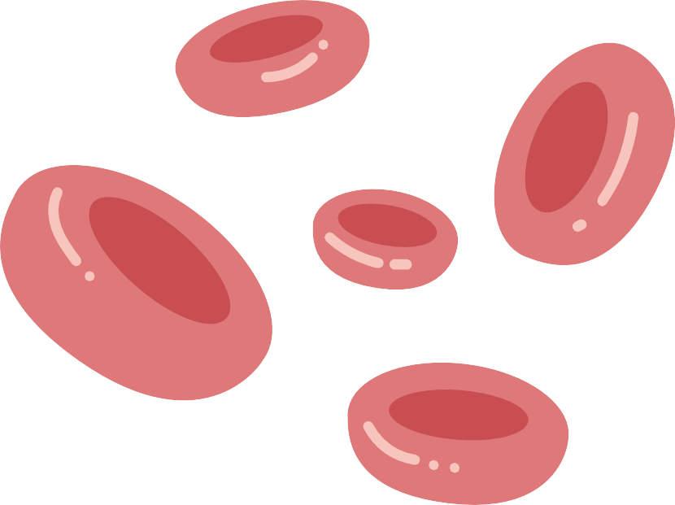









LEUKEMIA DETECTION
USING
CONVOLUTIONAL NEURAL NETWORKS
Jumana Lightwala - C0892358 Bibek Shiwakoti - C0898100 Ronak Shah - C0891297 Pratikkumar Mishra - C0891298

Slide 2




INTRODUCTION
Leukemia Overview:
Leukemia is a cancer affecting blood and bone marrow, leading to the overproduction of abnormal white blood cells. This disrupts normal blood cell production, causing serious health issues like anemia, infections, and bleeding.
Importance of Early Detection:
Early detection is critical for effective treatment and significantly improves patient outcomes.
Objective: Using CNNs for Accurate Detection:
We aim to develop Convolutional Neural Networks (CNNs) to automatically detect leukemia from blood smear images.
CNNs are ideal for this task due to their ability to learn complex patterns in images, offering high accuracy and reducing reliance on manual methods.

Slide 3

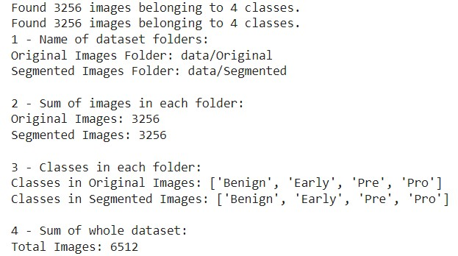

DATASET OVERVIEW
Source: Kaggle, provided by Mehradaria
Dataset Parts: Original, Segmented
Classes: Benign, Early Pre-B,
Pre-B, Pro-B
Split: Training and Validation Sets
Sample image from the dataset

Slide 4



METHEDOLOGY
Model Architectures:
Original Model: A baseline CNN with layers for convolution, max- pooling, and dense output, utilizing Batch Normalization and L2 regularization to maintain model stability.
Segmented Model: Modified to enhance feature extraction and generalization.
Combined Model: Merges features from both original and segmented models to maximize performance.
Data Preprocessing:
Resizing: Images are resized to 224x224 pixels for consistent input dimensions.
Normalization: Pixel values are scaled between 0 and 1 for improved training speed.
Data Augmentation: Applied techniques like rotations, shifts, and flips to increase data diversity and combat overfitting.
1
2

Slide 5


METHEDOLOGY
Training Approach:
3
Adam Optimizer: Efficient optimization with gradient descent.
ReduceLROnPlateau: Dynamically reduces learning rate when validation loss stagnates.
Early Stopping: Halts training when no further improvement in validation loss is observed.

Slide 6
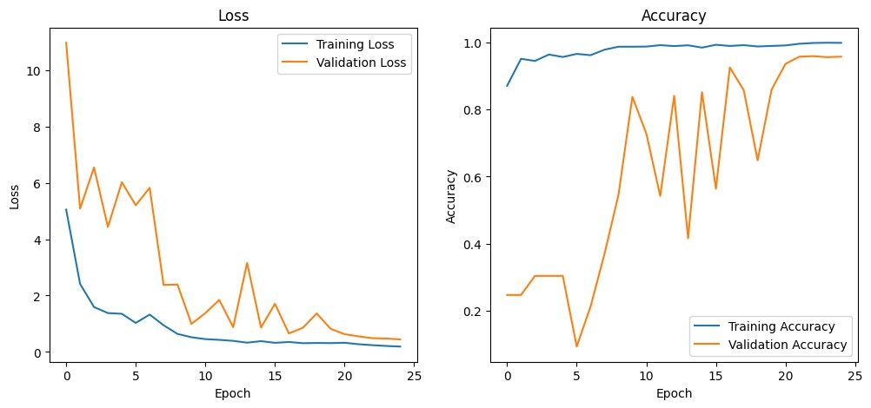
RESULTS - MODEL PERFORMANCE
Original Dataset

Slide 7
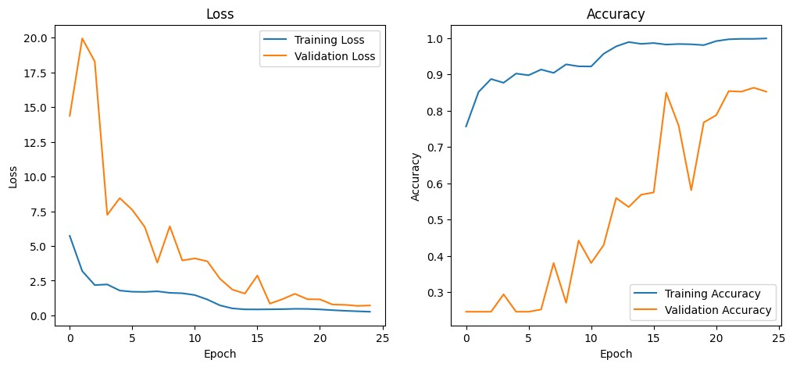
RESULTS - MODEL PERFORMANCE
Segmented Dataset

Slide 8
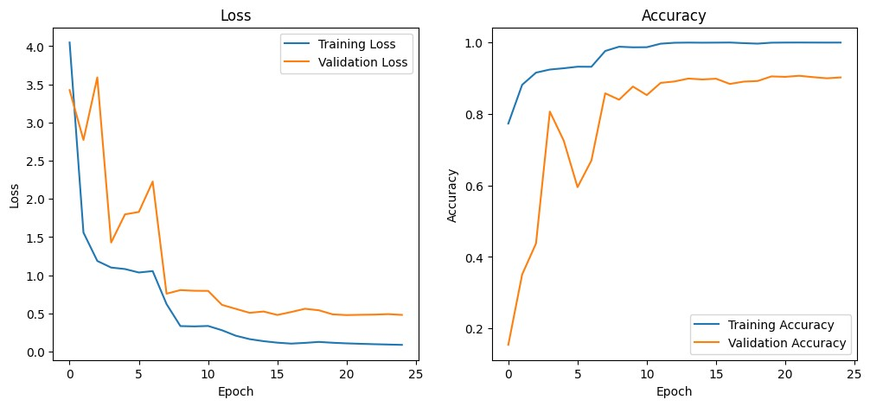
RESULTS - MODEL PERFORMANCE
Combined Dataset

Slide 9

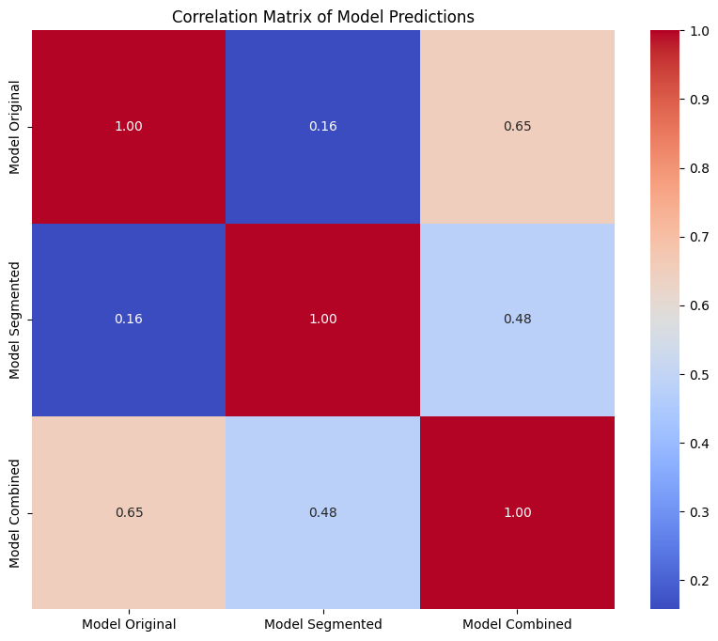

CORRELATION MATRIX

Slide 10
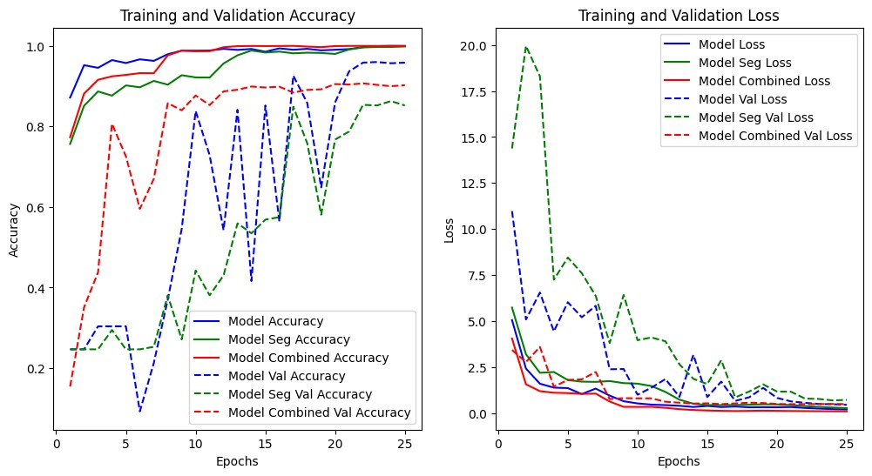
COMPARISION OF ACCURACY AND LOSS

Slide 11
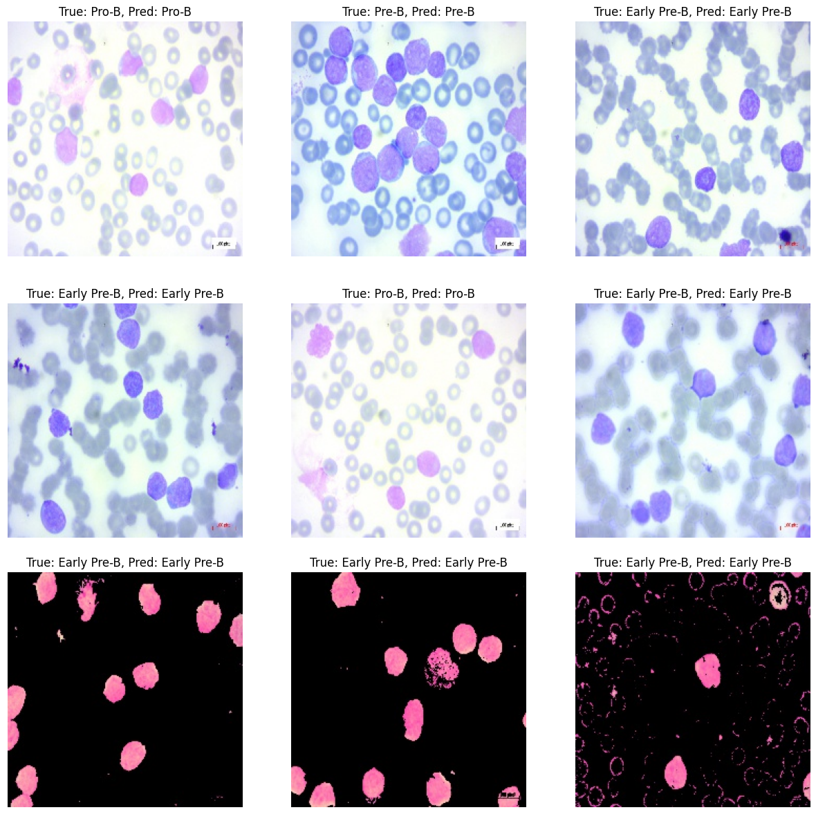

SAMPLE PREDICTIONS

Slide 12


STRENGHTS
CNNs effectively detected leukemia with high classification accuracy.
Data augmentation and regularization (Batch Normalization, L2, Dropout) reduced overfitting and improved generalization.
Combining different CNN models leveraged their strengths for better analysis.
Early stopping and learning rate reduction enhanced training efficiency and stability.
LIMITATIONS
Validation accuracy variability suggests a need for further hyperparameter tuning.
The dataset's size and diversity may limit the model's generalization to unseen data.
Potential overfitting in the Segmented model, indicated by erratic validation accuracy.

Slide 13


FUTURE WORK
Explore more advanced architectures or transfer learning to further enhance model accuracy and robustness.
Increase the dataset size and variety to improve generalization.
Investigate additional techniques like ensemble learning or fine-tuning to reduce overfitting and improve validation performance.

Slide 14
REFERENCES
3
M. Mehradaria, Kaggle, Leukemia Detection Dataset. [Online]. Available: https://www.kaggle.com/datasets/mehradaria/leukemia-detection.
F. Chollet, Deep Learning with Python, 2nd ed., Manning Publications, 2021.
I. Goodfellow, Y. Bengio, and A. Courville, Deep Learning, MIT Press, 2016.

Slide 15

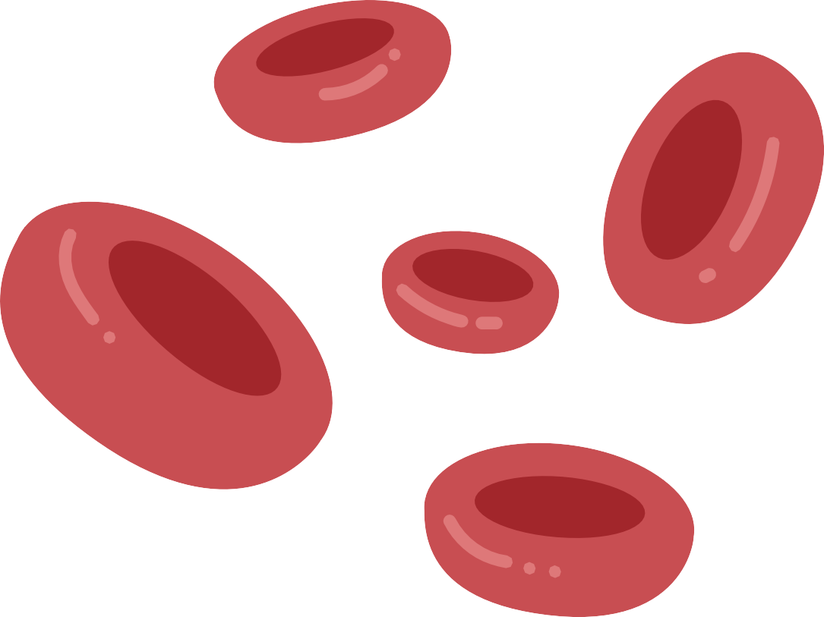

Q & A
“Thank you for your attention! We are now open to any questions you may have.”

